Slide 1

Euclidean and Cityblock
Politeknik Negeri Malang
2023
Endah Septa Sintiya,S.Pd.,M.Kom

Slide 2
Learning Objectives
Students are capable of understanding and finding solutions for the general formula 1 (Euclidean and City block) case study.

Slide 3
Euclidean distance

Slide 4
4 Distance Measures for Machine Learning
Hamming Distance
Euclidean Distance
Manhattan Distance (Taxicab or City Block)
Minkowski Distance
https://machinelearningmastery.com/distance-measures-for-machine-learning/#:~:text=The%20Manhattan%20distance%2C%20also%20called,a%20chessboard%20or%20city%20blocks.

Slide 5
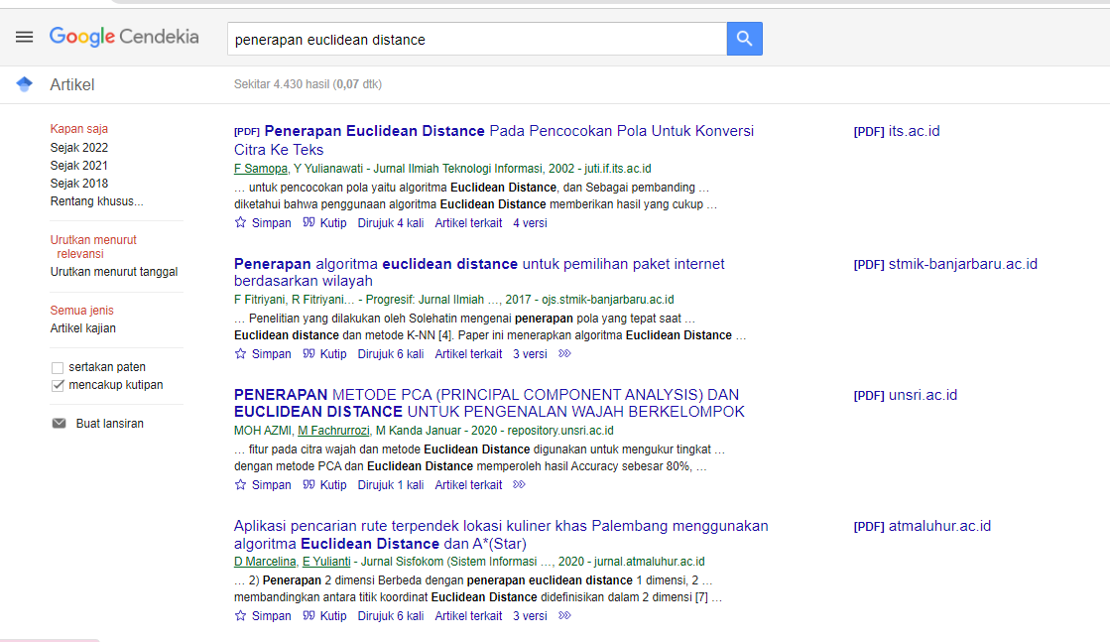
Euclidean untuk apa?

Slide 6
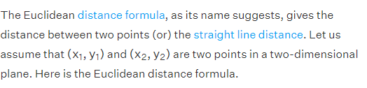
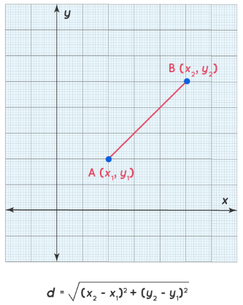
What Is Euclidean Distance Formula?
Euclidean distance adalah perhitungan jarak dari 2 buah titik dalam Euclidean space. Euclidean space diperkenalkan oleh Euclid, seorang matematikawan dari Yunani sekitar tahun 300 B.C.E. untuk mempelajari hubungan antara sudut dan jarak. Euclidean ini berkaitan dengan Teorema Phytagoras dan biasanya diterapkan pada 1, 2 dan 3 dimensi. Tapi juga sederhana jika diterapkan pada dimensi yang lebih tinggi.

Slide 7
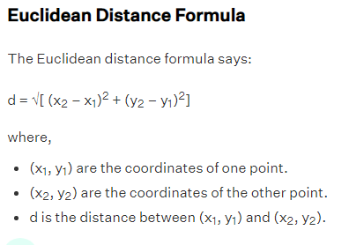
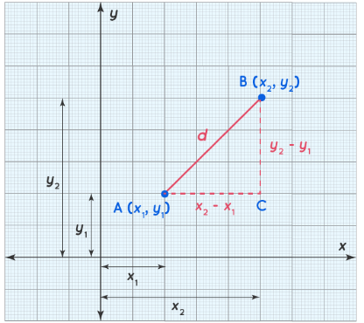
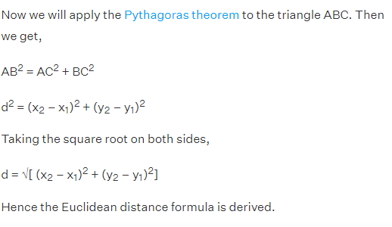

Slide 8
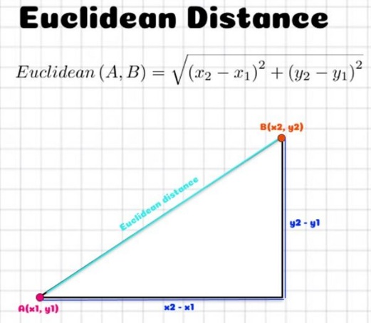

Slide 9
Examples Using Euclidean Distance Formula
Example 1: Find the distance between points P(3, 2) and Q(4, 1).
Solution:
Given:
P(3, 2) = (x1,y1)(x1,y1)
Q(4, 1) = (x2,y2)(x2,y2)
Using Euclidean distance formula,
d = √[(x22 – x11)² + (y22 – y11)²]
PQ = √[(4 – 3)² + (1 – 2)²]
PQ = √[(1)² + (-1)²]
PQ = √2 units.
Answer: The Euclidean distance between points A(3, 2) and B(4, 1) is √2 units.

Slide 10
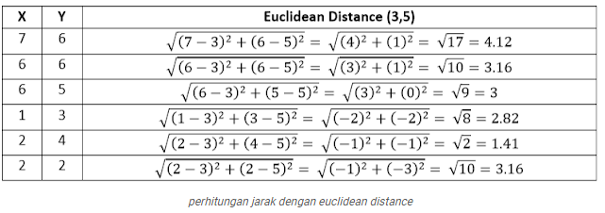
Examples Using Euclidean Distance Formula

Slide 11
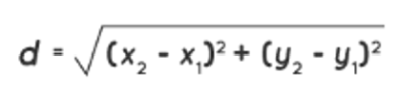

Task 1:
Euclidean Formula:
With values X and Y as follows
Hitung nilai $d_{Eue}$
Find the Euclidean distance from the center at (2, 4)
X | 2 | 3 | 5 | 7 | 6
Y | 4 | 6 | 3 | 1 | 8

Slide 12
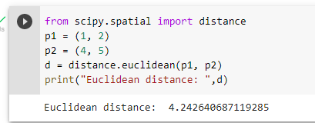
Task 2
Please calculate manually to obtain the final value from the following code:

Slide 13
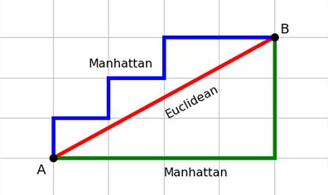
Manhattan Distance (city block distance)

Slide 14
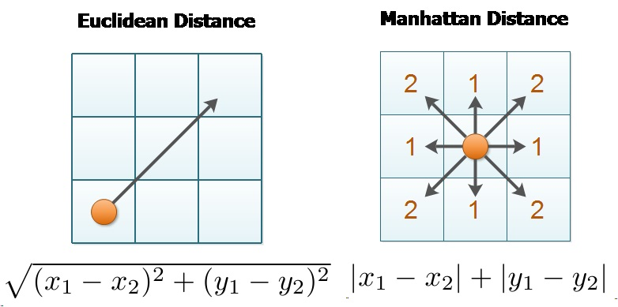

Slide 15
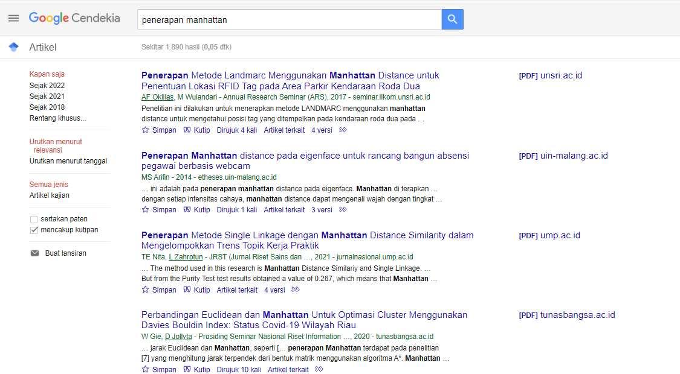
What is Manhattan/City Block used for?

Slide 16
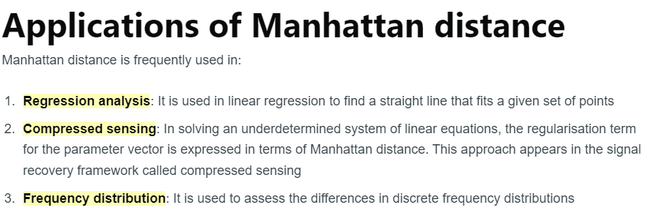

Slide 17
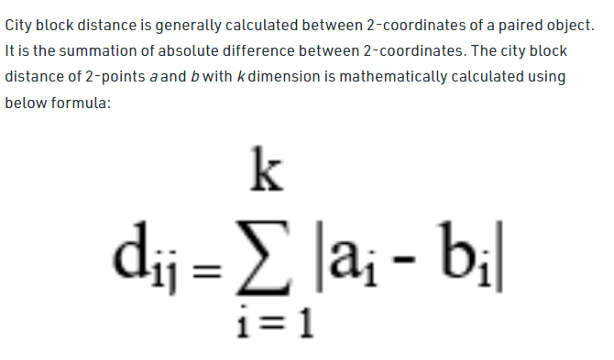
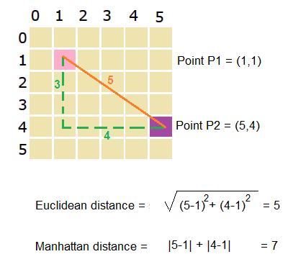

Slide 18
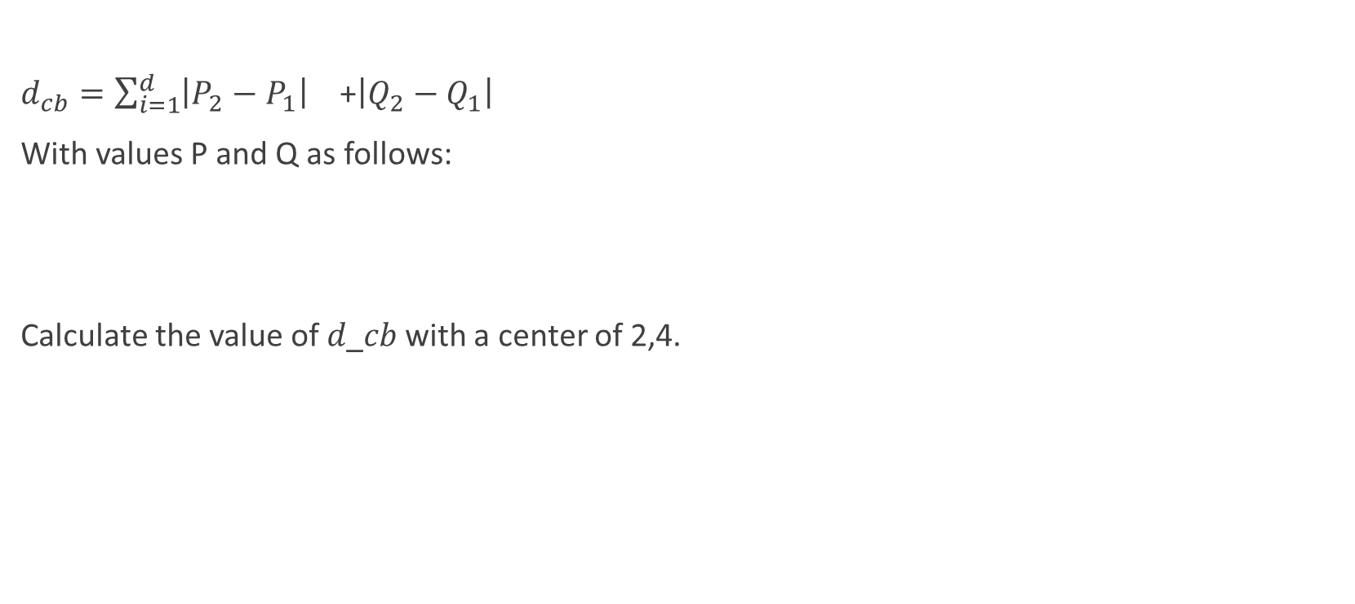
Task 3
$d_{cb}=\sum_{i=1}^{d}{{\left|P_{2}−P_{1}\right|}^{}}$ +${\left|Q_{2}−Q_{1}\right|}^{}$
With values P and Q as follows:
Calculate the value of 𝑑_𝑐𝑏 with a center of 2,4.
P | 2 | 3 | 5 | 7 | 6
Q | 4 | 6 | 3 | 1 | 8

Slide 19
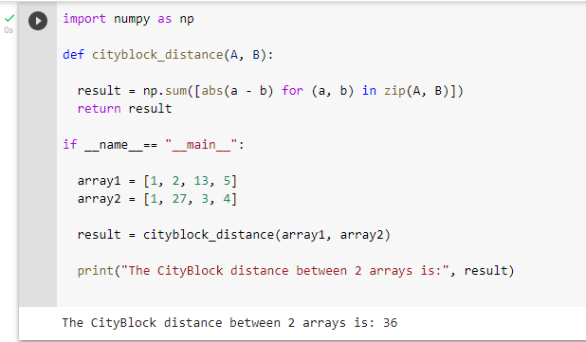
Task 4
Please calculate manually to obtain the following final value from the following code:

Slide 20
Task 5
Create an additional summary regarding Euclidean and City Block distances in 3 dimensions and n dimensions, including
Definitions
Formulas
real-life examples

Slide 21
Assignments 1-5 are to be submitted on the LMS by 6:00 PM WIB at the latest
Format : pdf, nama file: nim_nama lengkap

Slide 22
Reference
https://www.cuemath.com/euclidean-distance-formula/

